Slide 1

Sale Analytics Capstone Project By Tanmeet Singh

Slide 2
To identify key factors influencing customer retention or loyalty based on the provided dataset, we can analyze various aspects related to customer behavior, order history, product details, supplier relationships, and employee interactions. Here's a breakdown of potential key factors and how they might influence customer retention or loyalty:

Slide 3
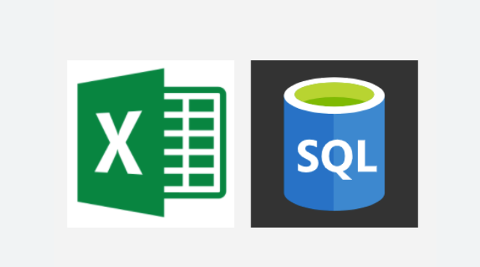
Excel and SQL have been used in the first module of the Project

Slide 4
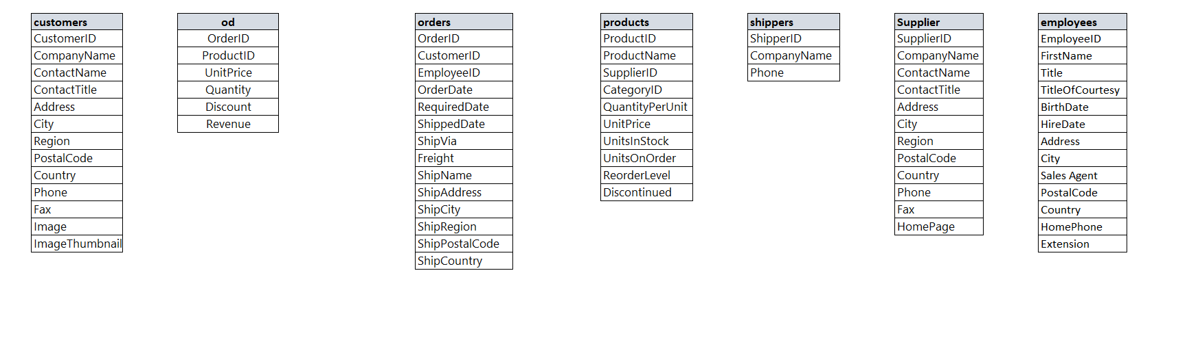

Slide 5
Order History: Frequency of orders: Customers who make regular purchases are likely more loyal. Order value: Higher-value orders might indicate stronger loyalty. Order dates: Patterns in ordering behavior could reveal seasonal trends or regular purchasing cycles. Product Details: Product popularity: Products frequently ordered by customers may contribute to retention. Product diversity: Offering a wide range of products might keep customers engaged. Product quality: Consistently delivering high-quality products can enhance loyalty. Supplier Relationships: Reliability of suppliers: Dependable suppliers ensure timely delivery and quality products. Supplier diversity: Working with multiple reliable suppliers can mitigate risks and maintain product availability Employee Interactions: Customer service quality: Positive interactions with employees may enhance customer satisfaction and loyalty. Employee engagement: Engaged and knowledgeable employees can provide better assistance, improving the overall customer experience. Discounts and Promotions: Effectiveness of discounts: Analyzing the impact of discounts on customer retention. Frequency of promotions: Regular promotions may incentivize repeat purchases. Shipping and Logistics: Timeliness of delivery: Prompt shipping can improve customer satisfaction and retention. Shipping options: Offering flexible shipping options might cater to different customer preferences. Customer Demographics: Geographic location: Regional preferences and trends may influence purchasing behavior. Customer segment analysis: Identifying key customer segments with higher retention rates. Customer Feedback: Reviews and feedback: Monitoring customer feedback to address concerns and improve satisfaction. Net Promoter Score (NPS): Measuring customer likelihood to recommend the brand to others.

Slide 6
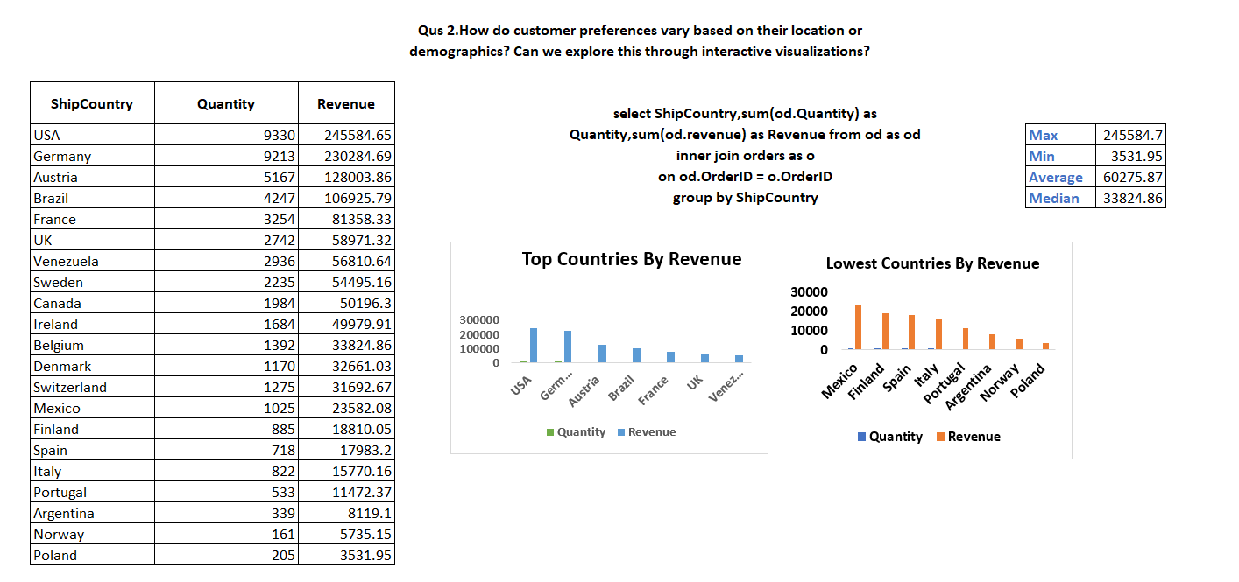

Slide 7
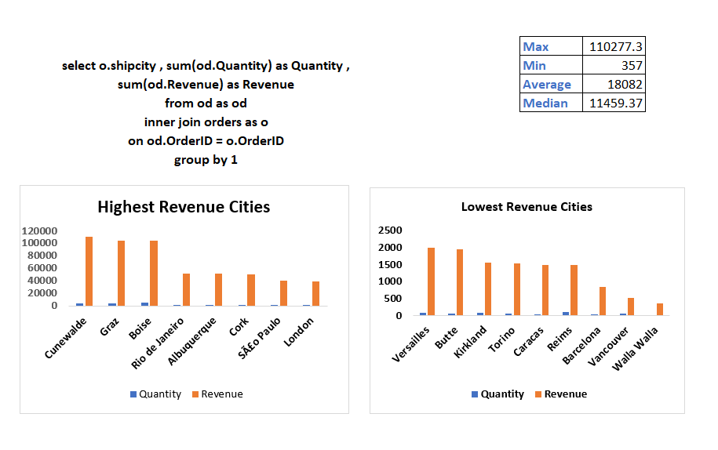

Slide 8
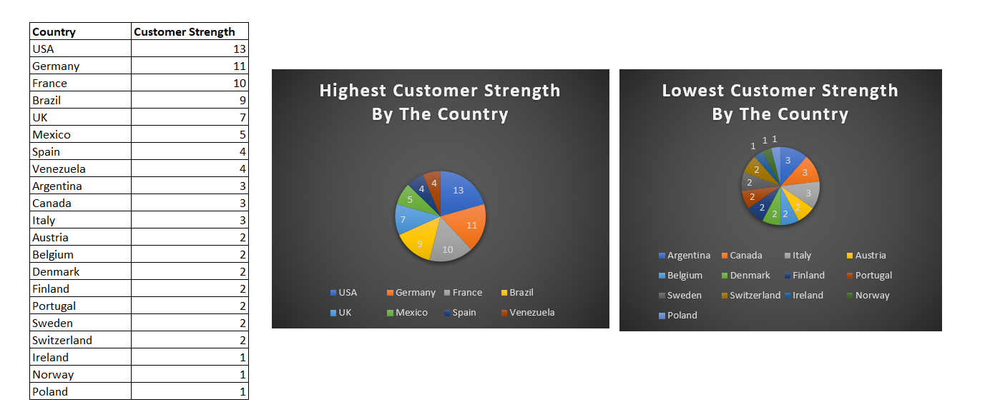

Slide 9
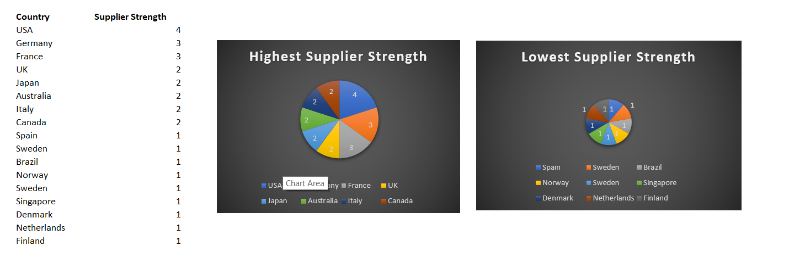

Slide 10
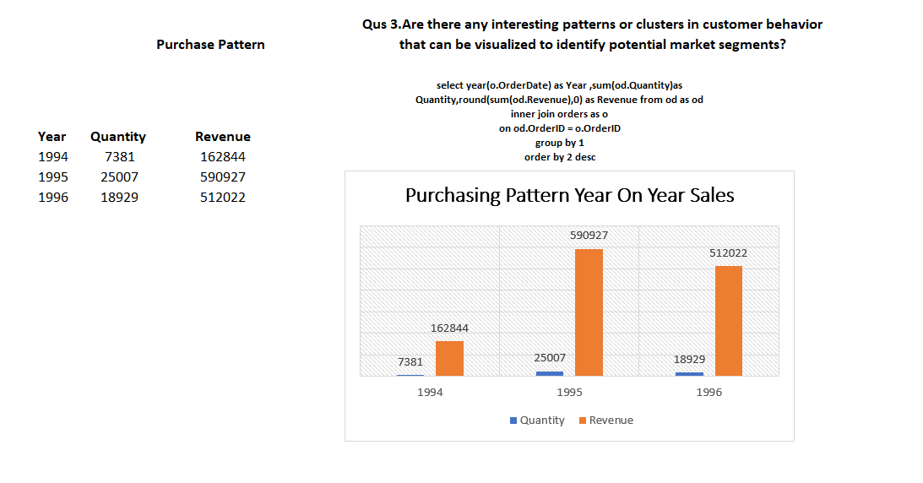

Slide 11
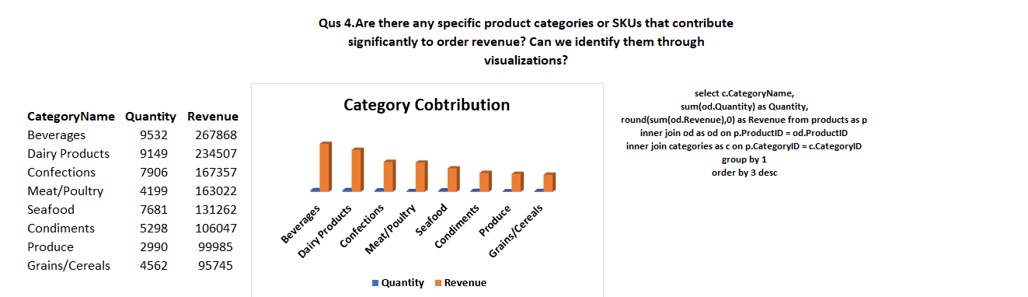

Slide 13
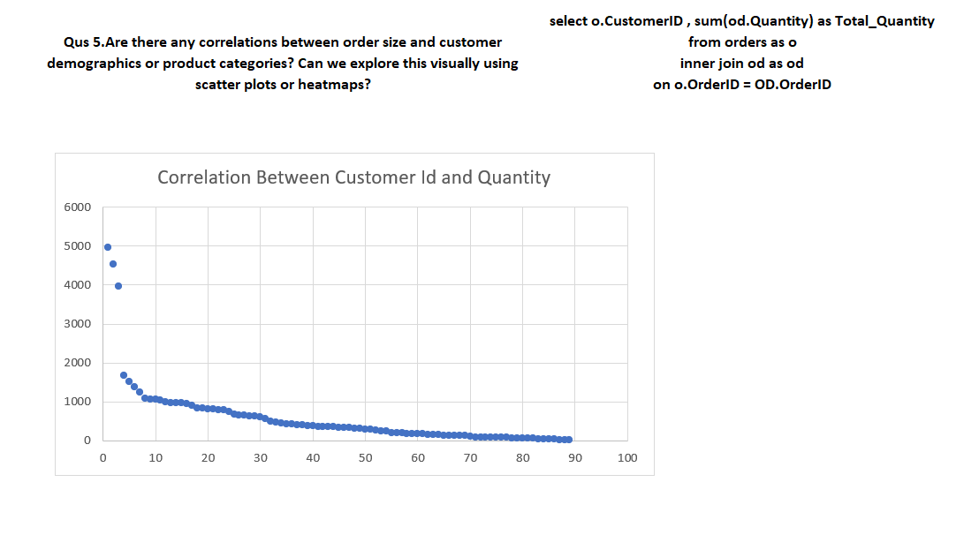

Slide 14
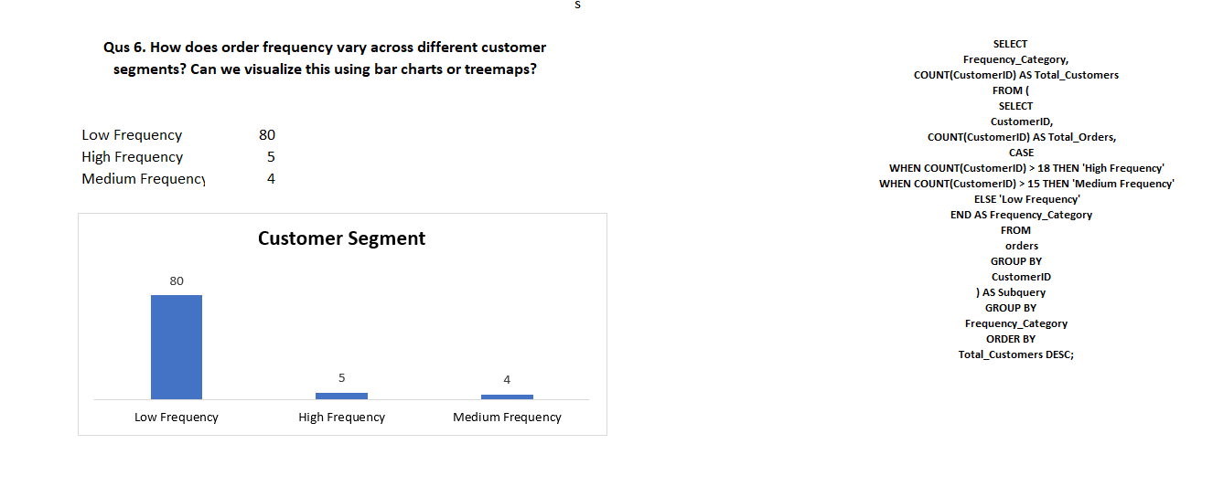

Slide 15
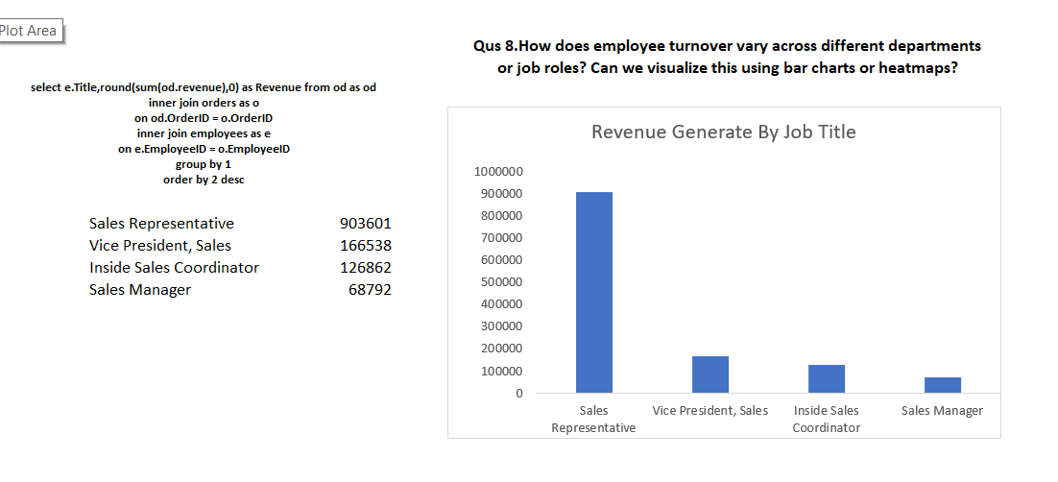

Slide 16
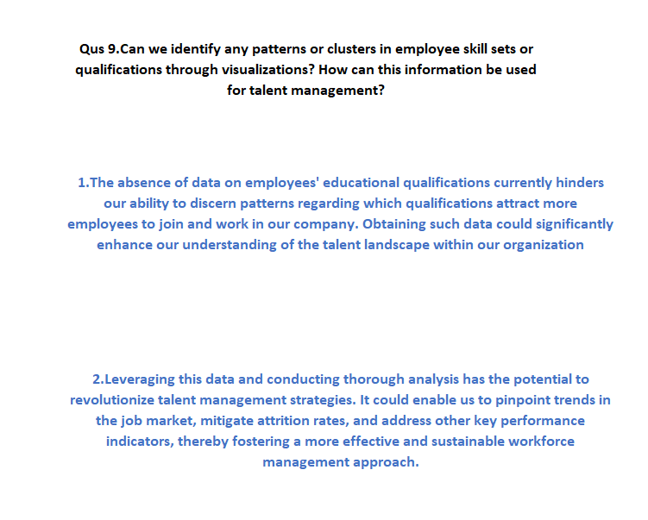

Slide 17
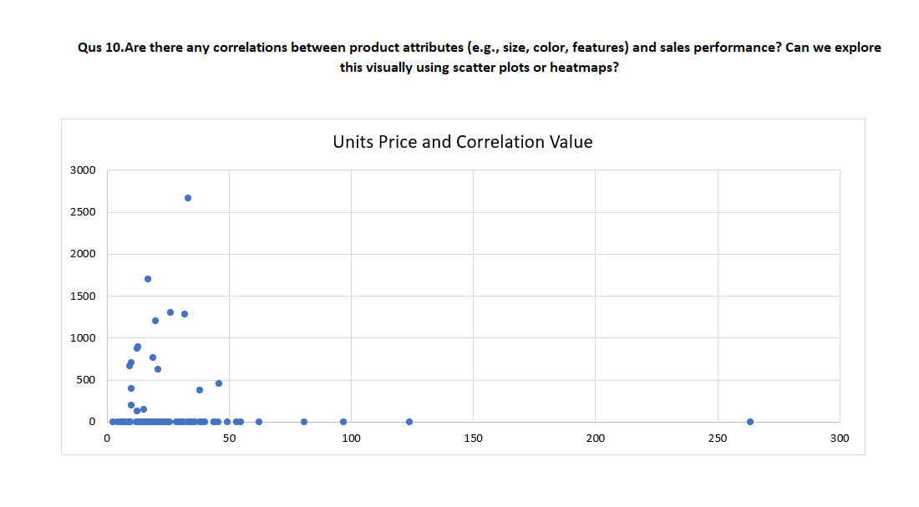

Slide 18
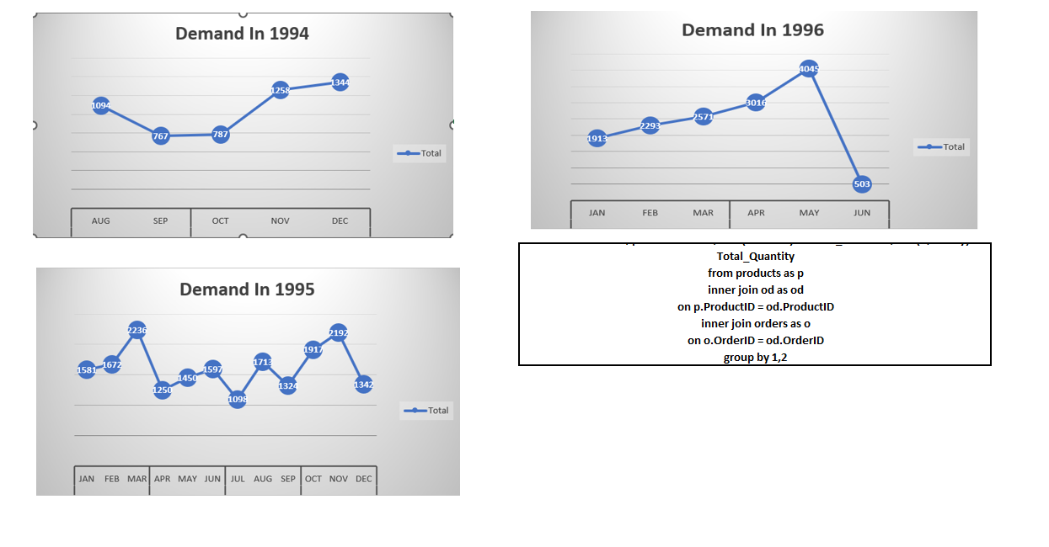
Qus 11

Slide 19
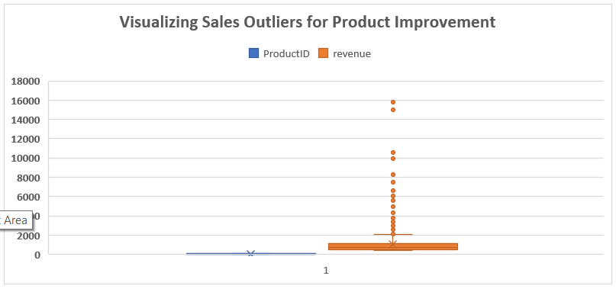
Qus12

Slide 20
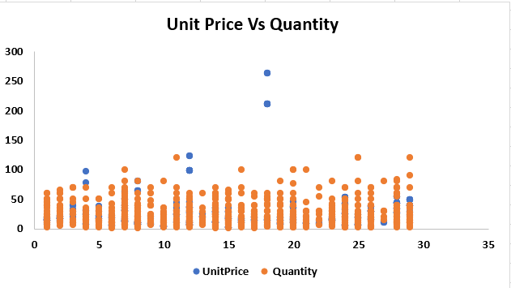
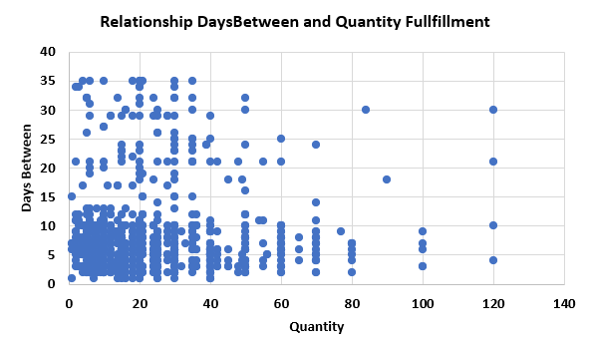
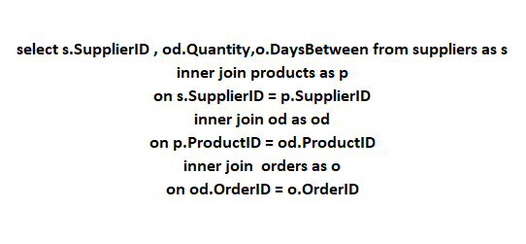
Qus13. Are there any correlations between supplier attributes (e.g., location, size, industry) and performance metrics (e.g., on-time delivery, product quality)? Can we explore this visually through scatter plots or heatmaps?

Slide 21
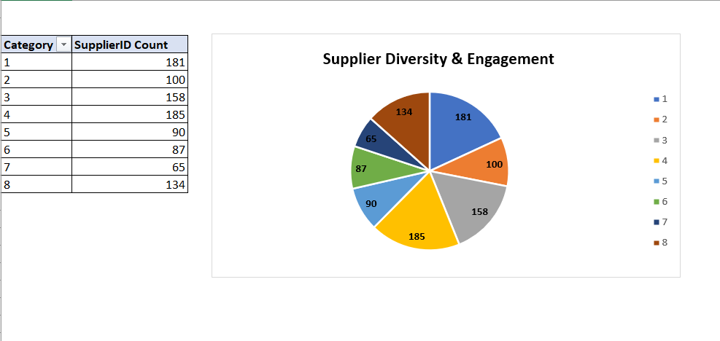
Qus14. How does supplier performance vary across different product categories or departments? Can we visualize this using stacked bar charts or grouped column charts?

Slide 22
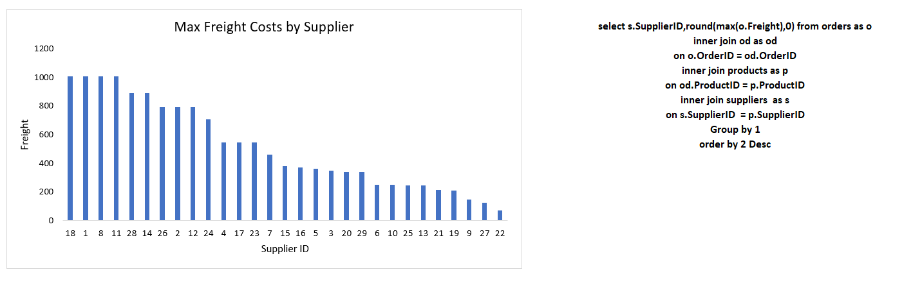
Qus15.Can we identify any trends or patterns in supplier costs or pricing structures through visualizations? How can this information be used for procurement optimization?

Slide 23
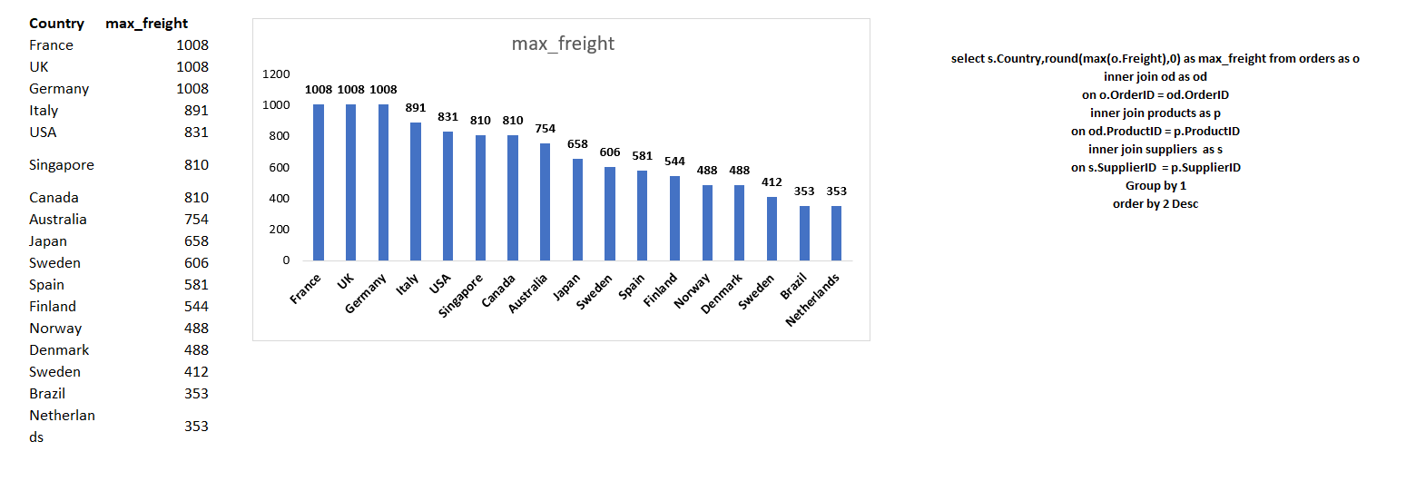

Slide 24
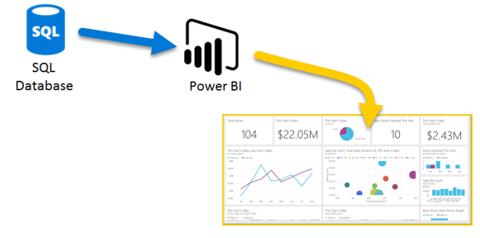
Power BI and SQL have been used in the second module of the project.

Slide 25
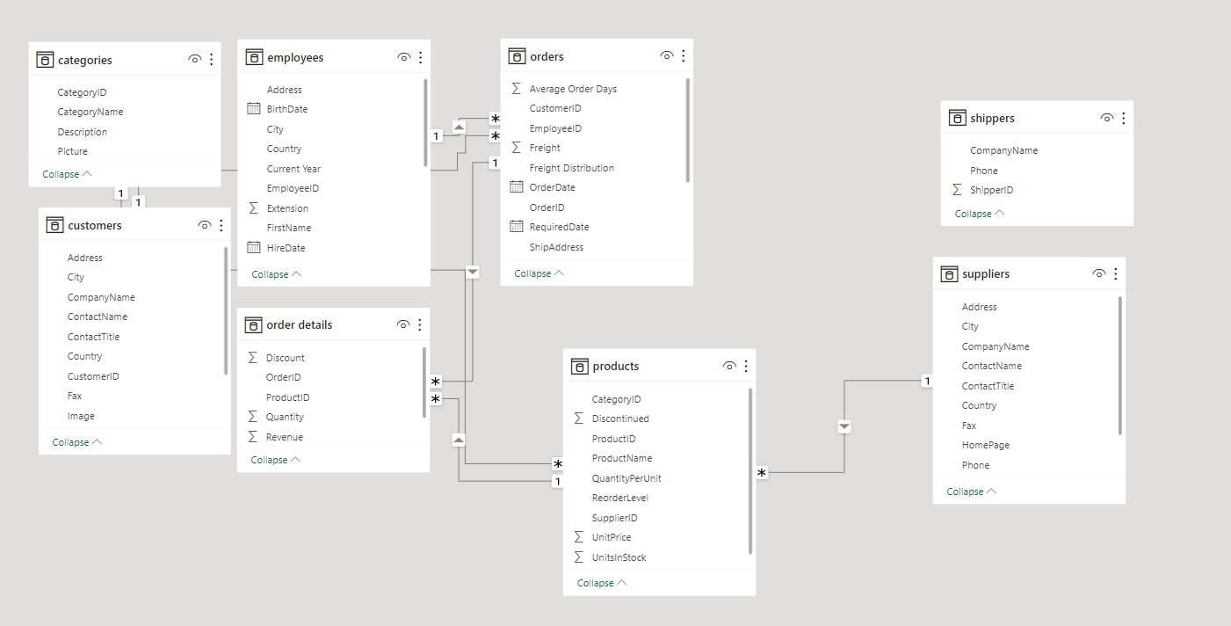
Schema

Slide 26
1.Customer Distribution: Region vs. Segment

Slide 27
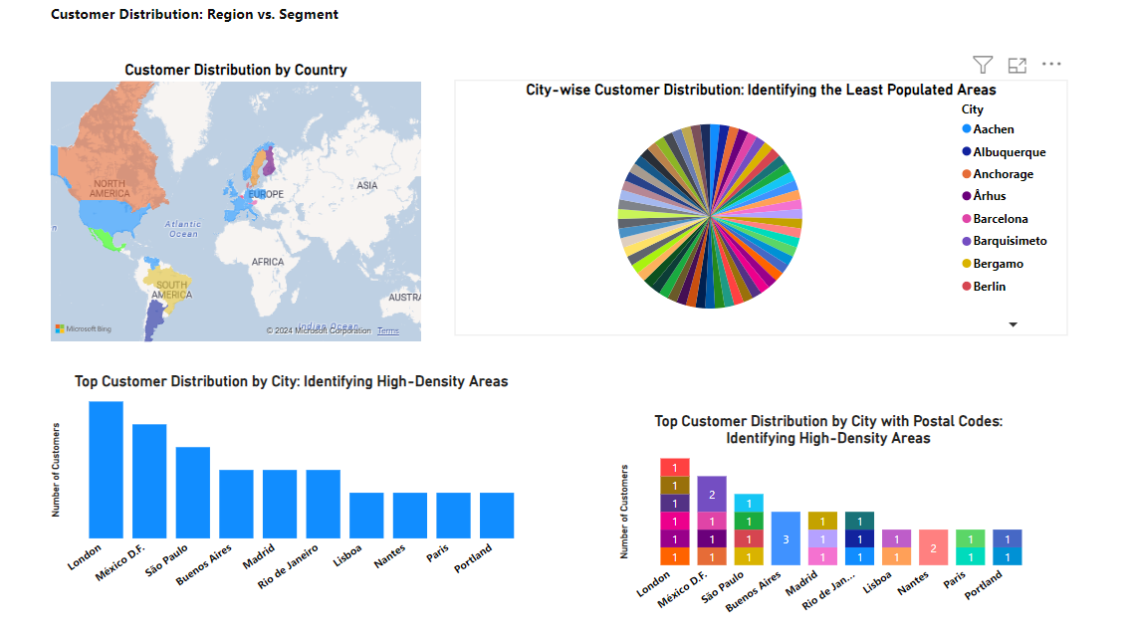
Analysis

Slide 28
Overview

Slide 29
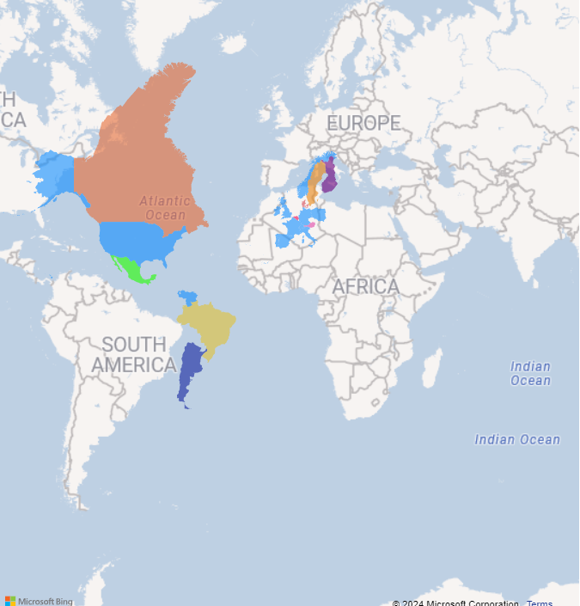
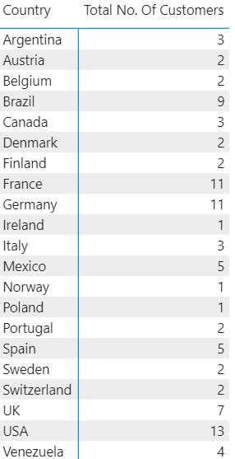
Customer Distribution by Country

Slide 30
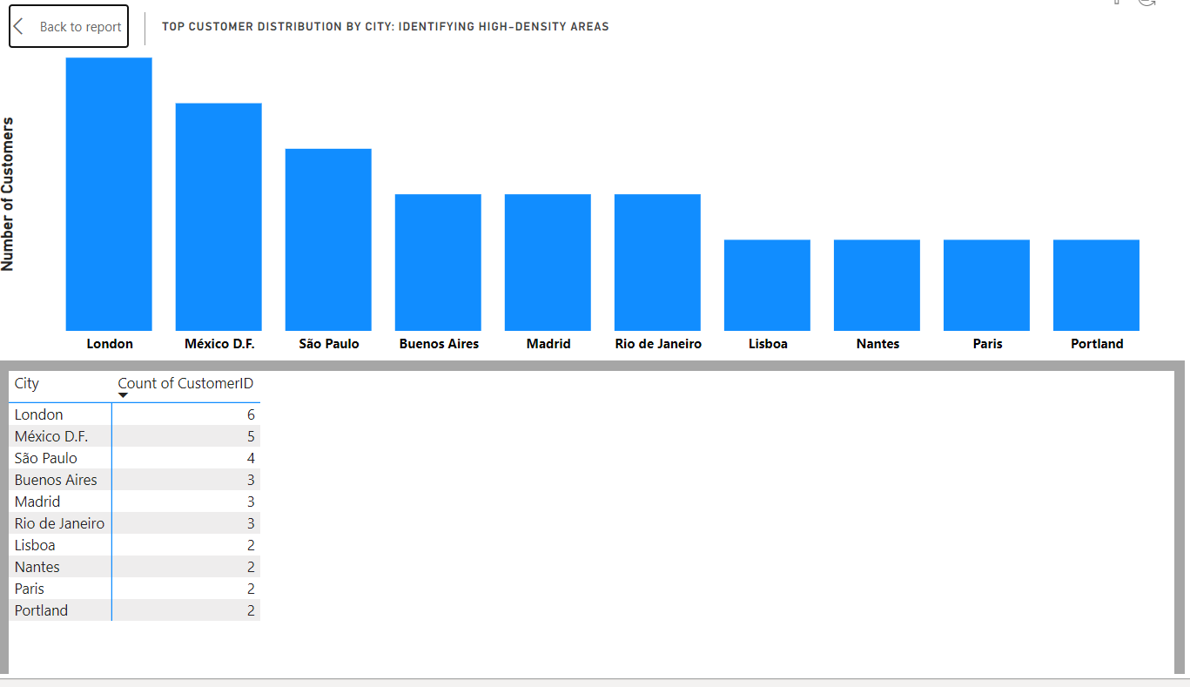
Top Customer Distribution by City: Identifying High-Density Areas

Slide 31
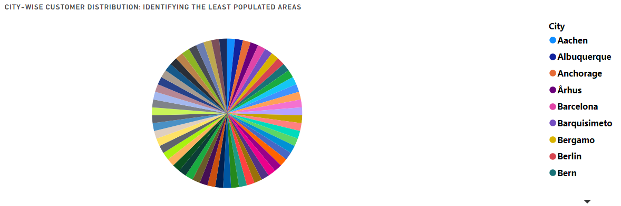
City-wise Customer Distribution: Identifying the Least Populated Areas
In this visual identity, after the city 'Rio de Janeiro,' all customer distribution is equal.

Slide 32
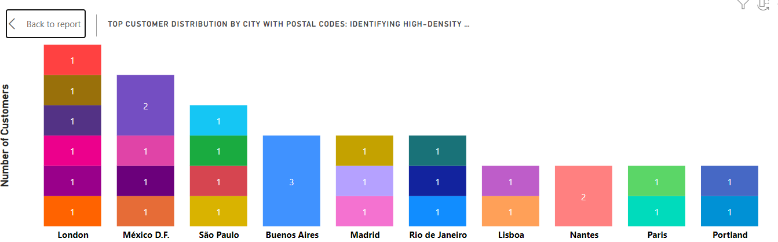
Top Customer Distribution by City with Postal Codes: Identifying High-Density Areas

Slide 33
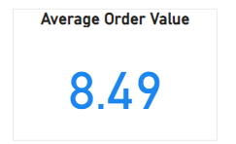
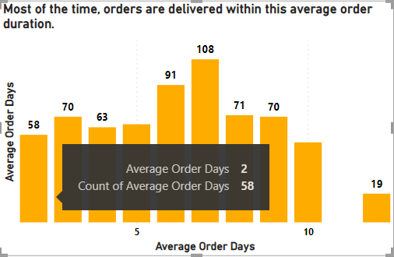

Slide 34
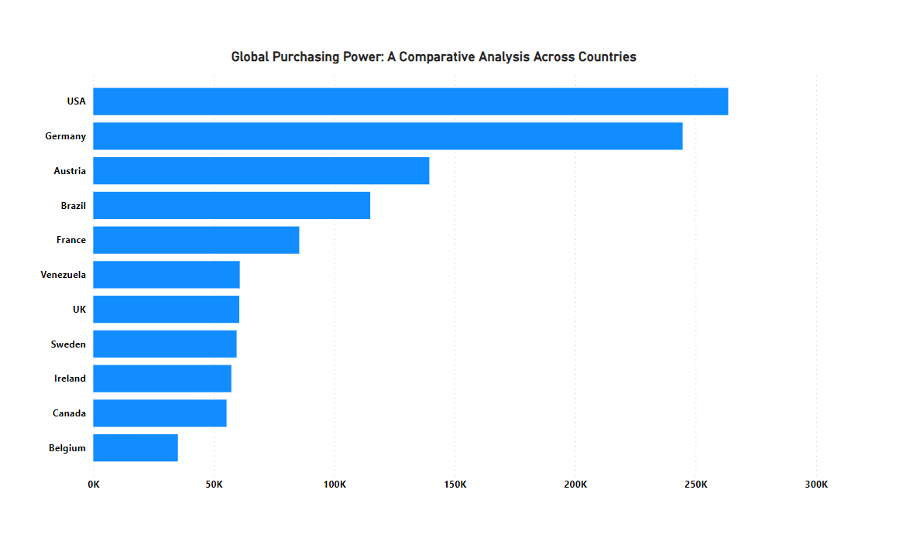
Global Purchasing Power: A Comparative Analysis Across Countries

Slide 35
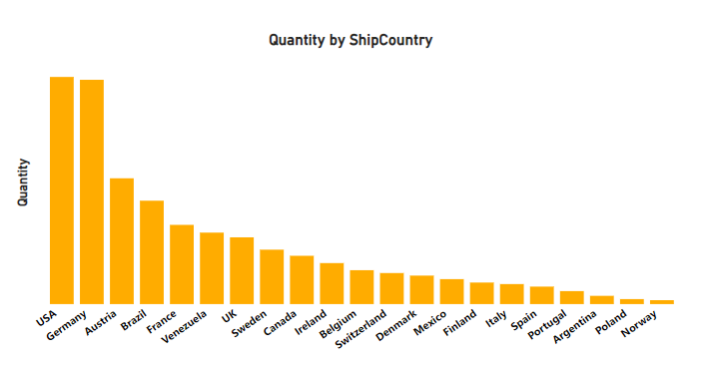

Slide 36
2.Customer Acquisition Trends Over Time: A Visual Analysis

Slide 37
In this project, we offer discounts to examine the trends of customer acquisition costs.

Slide 38
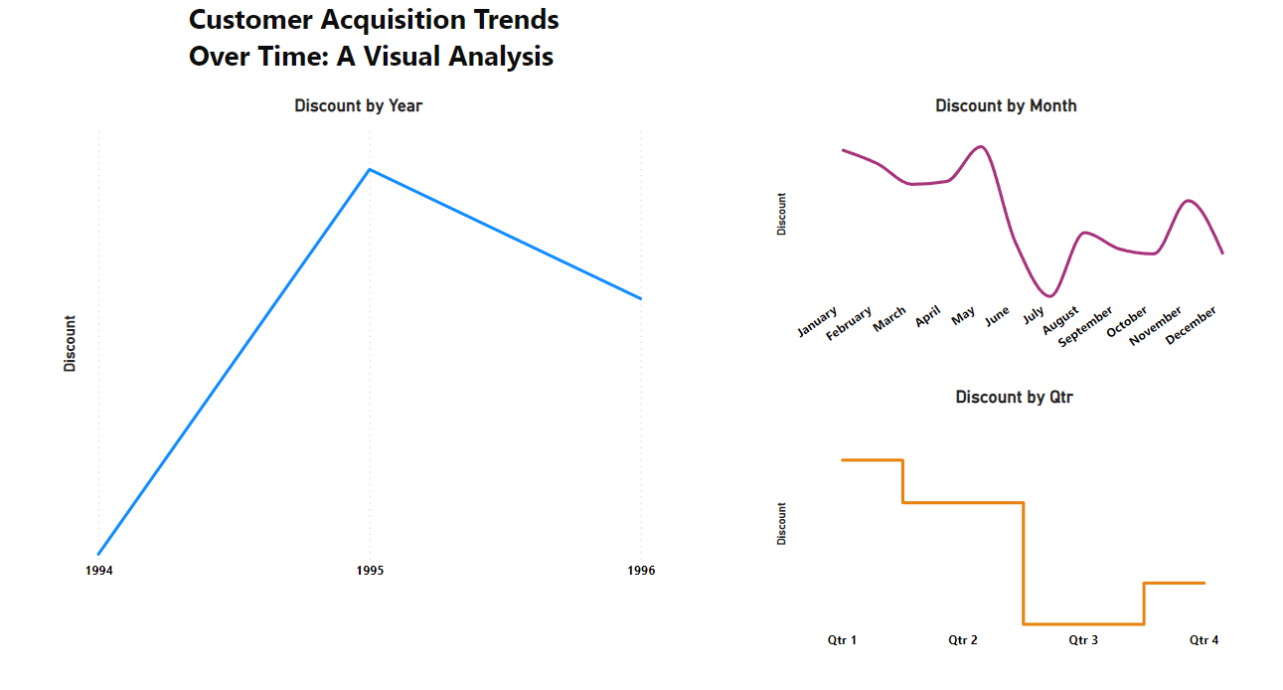
Customer Acquisition Trends Over Time: A Visual Analysis

Slide 39
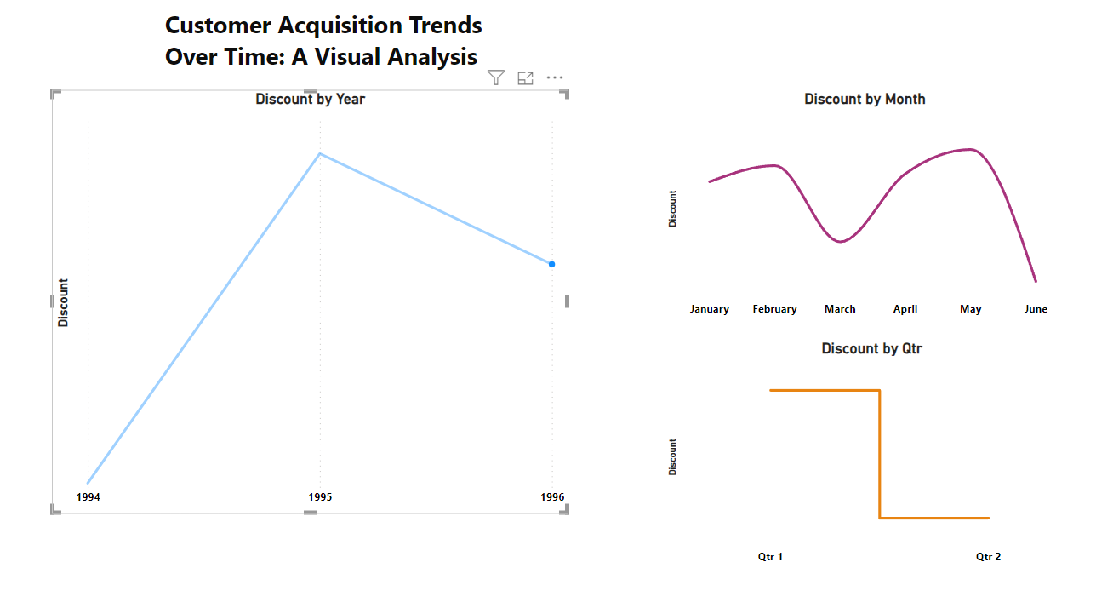
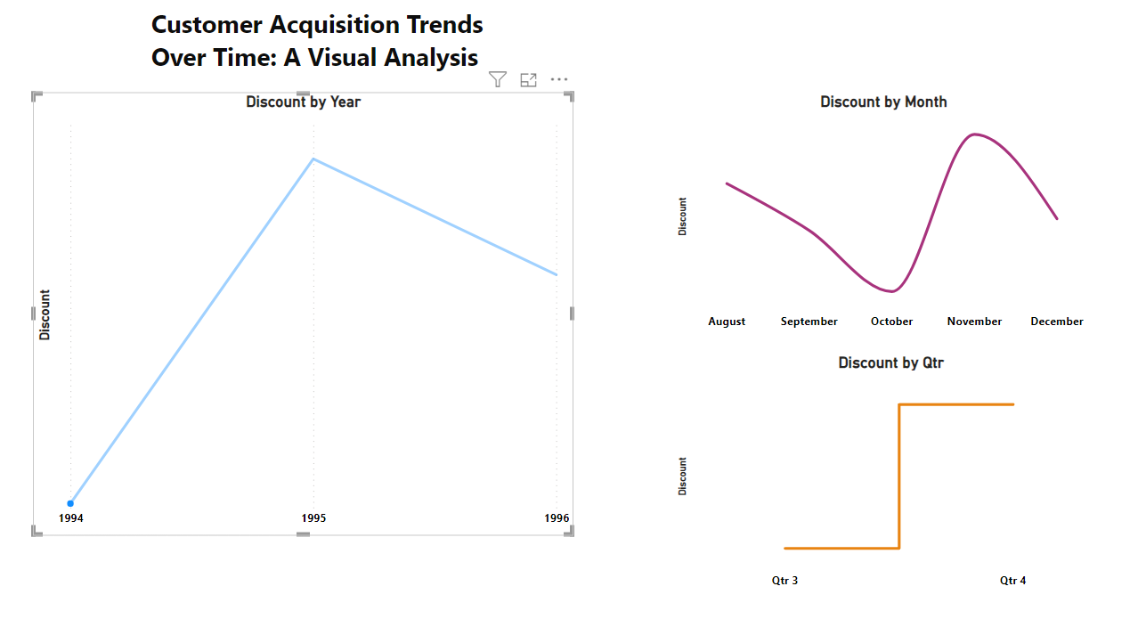
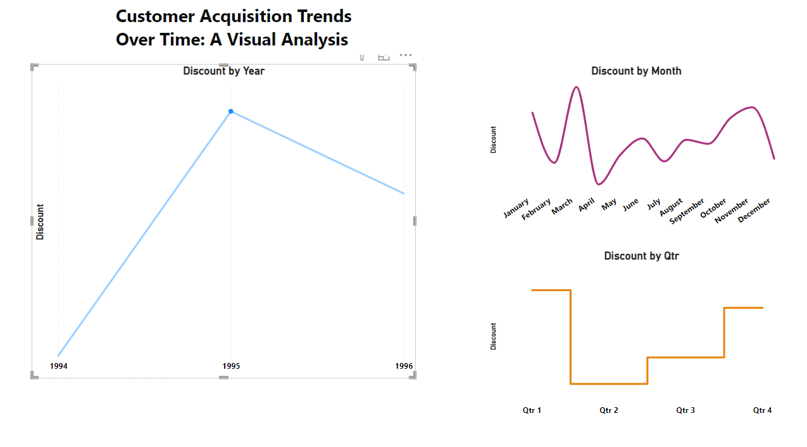
Year 1994
Year 1995
Year 1996

Slide 40
3.Can we visualize the distribution of customer demographics such as age, gender, or income using histograms or pie charts?

Slide 41
Question 3: It's not possible to solve because we don't have demographic data about the customer's age, gender, and income.

Slide 42
4.How does order volume change over time? Can we create a time series chart or stacked bar chart to visualize it?

Slide 43
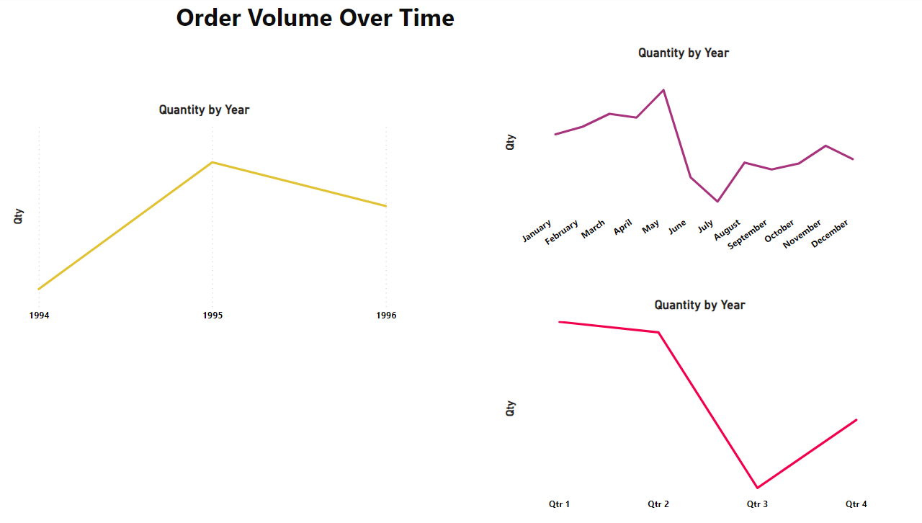
Order Volume Over Time

Slide 44
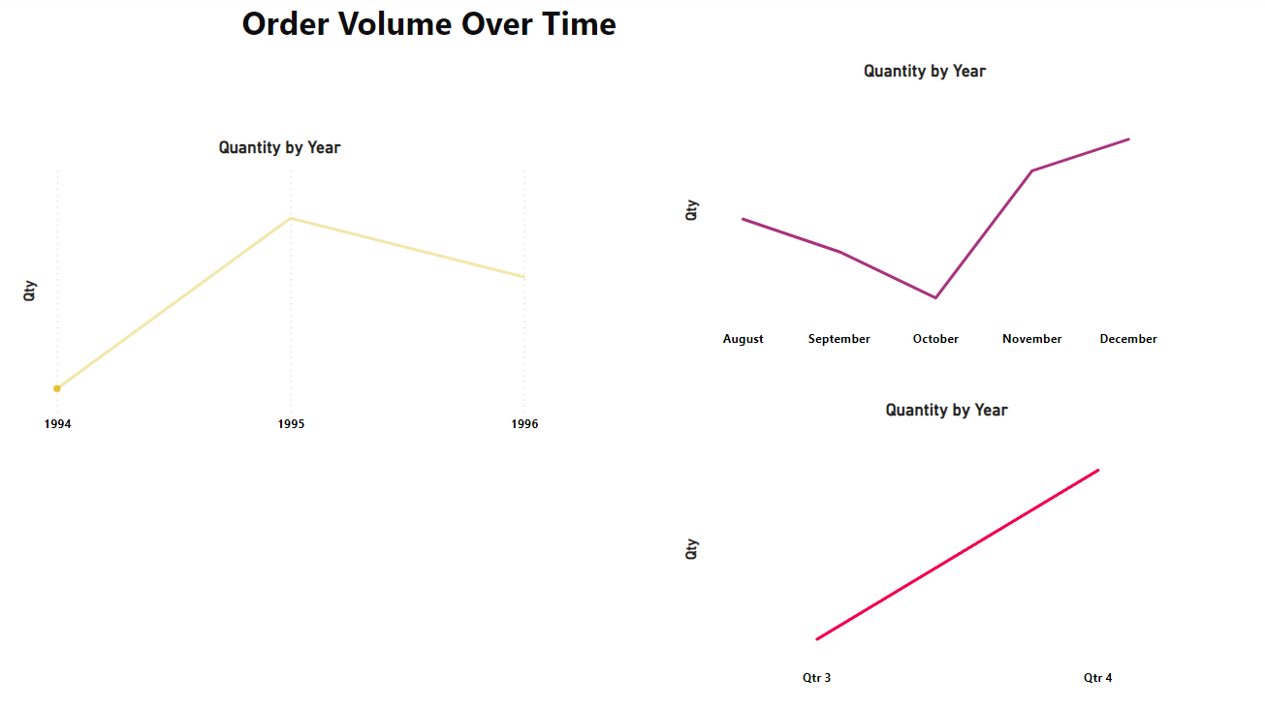
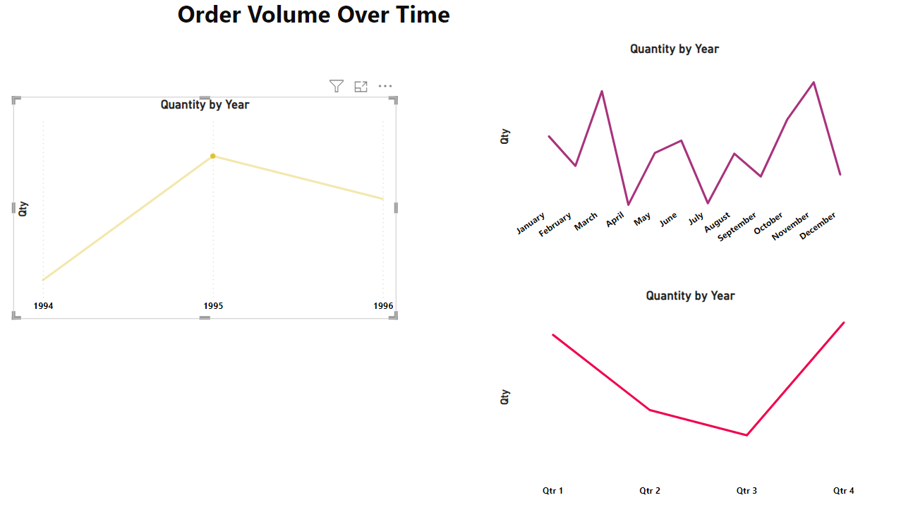
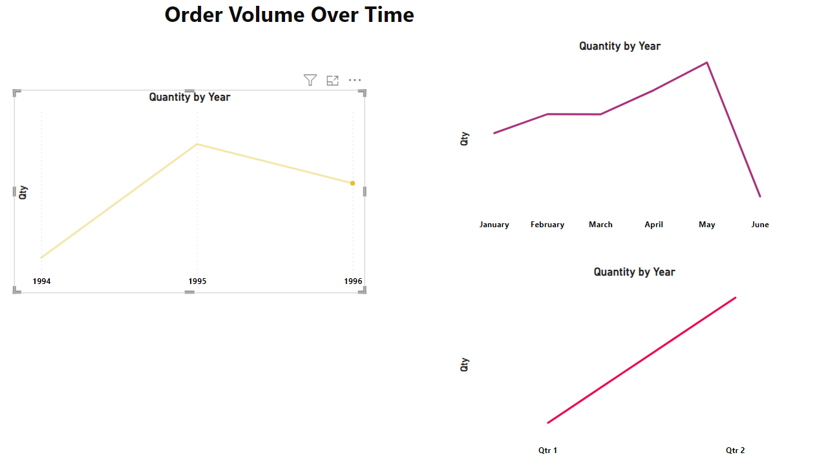
Year 1994
Year 1995
Year 1996

Slide 45
5.What is the distribution of order values? Can we create a histogram or box plot to display it?

Slide 46
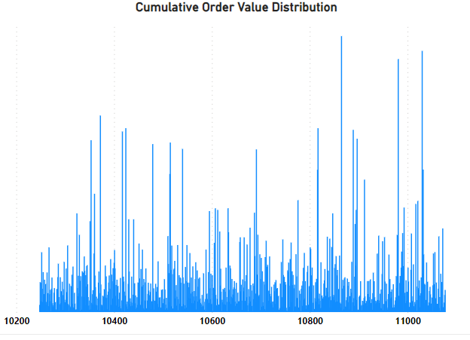
Order Value Distribution

Slide 47
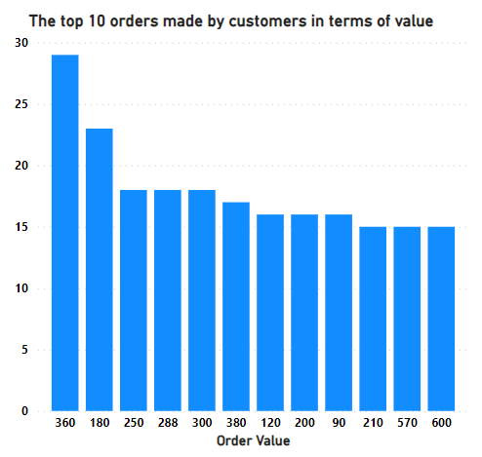
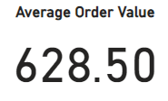

Slide 48
6.Can we visualize the average order processing time or shipping duration using a bar chart or box plot?

Slide 49
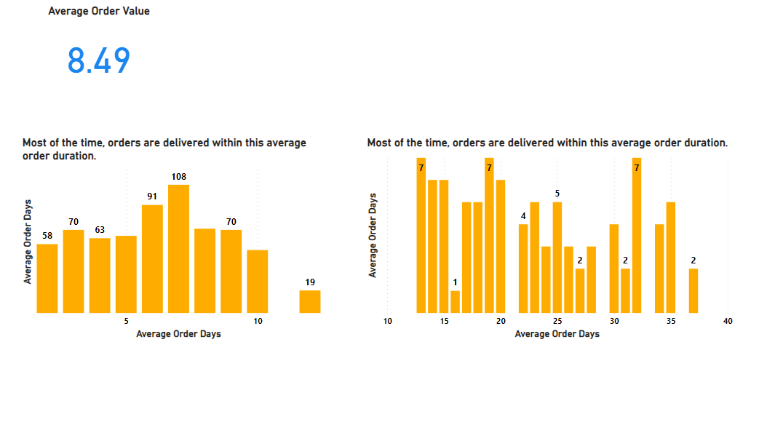

Slide 50
7. How does employee productivity vary across different departments or job roles? Can we create a stacked bar chart or grouped column chart to visualize it?

Slide 51
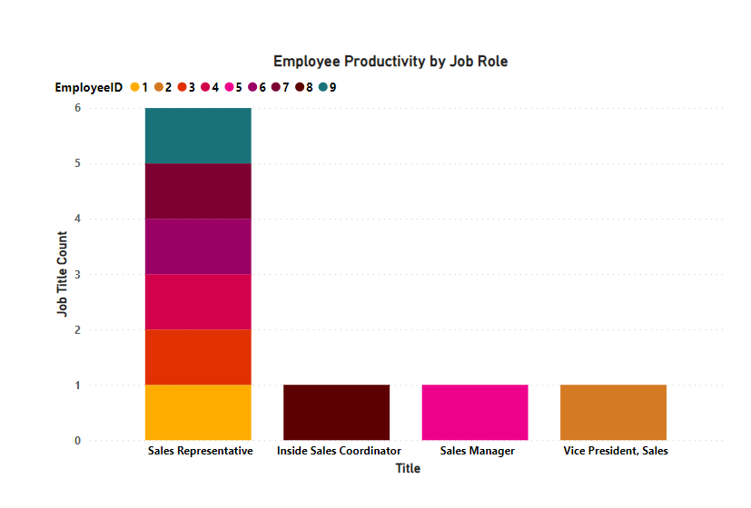
Employee Productivity by Job Role

Slide 52
Qus7.B We won't be able to determine employees by department because we don't have enough data related to departments."

Slide 53
8. What is the distribution of employee tenure? Can we create a histogram or box plot to display it?

Slide 54
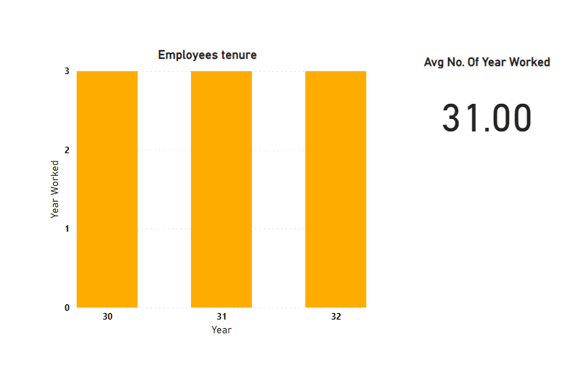

Slide 55
9.Can we visualize employee performance ratings or KPIs using a radar chart or bullet graph?

Slide 56
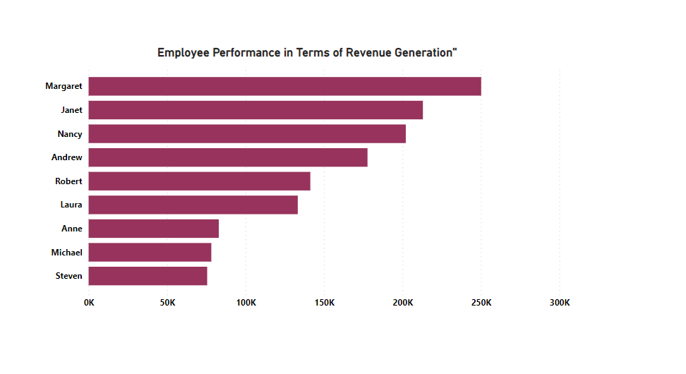

Slide 57
10.What is the distribution of product ratings or reviews? Can we create a histogram or stacked bar chart to visualize it?

Slide 58
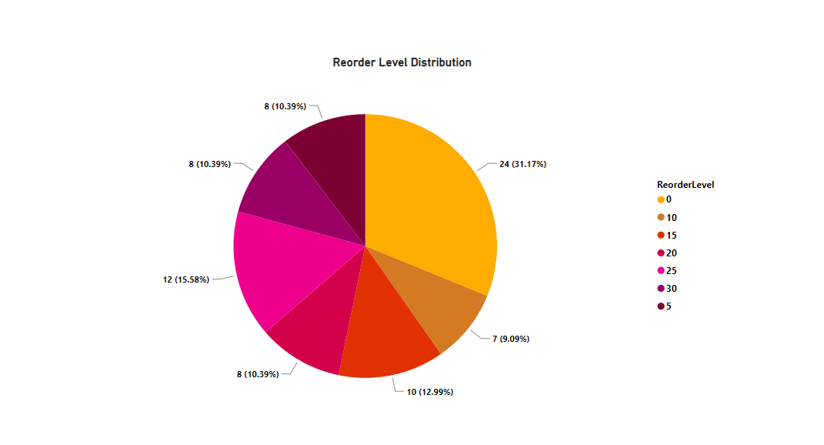
We assume that higher reorder values will correspond to higher product ratings.

Slide 59
11. How does the sales volume vary across different product categories? Can we create a bar chart or treemap to display it?

Slide 60
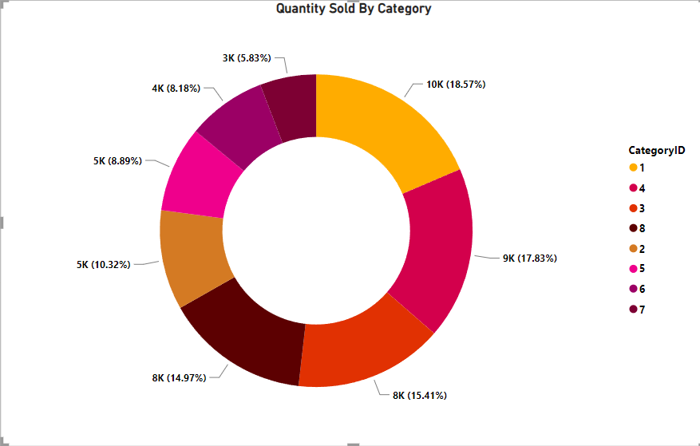

Slide 61


Slide 62



Slide 63
12.Can we visualize the pricing distribution of products using a box plot or violin plot?

Slide 64


Slide 65
13. What is the distribution of supplier ratings or performance metrics? Can we create a bar chart or radar chart to visualize it?

Slide 66


Slide 67


Slide 68


Slide 69
14.How does the cost or pricing structure vary across different suppliers? Can we create a box plot or stacked bar chart to display it?

Slide 70


Slide 71
15.Can we visualize the geographical distribution of suppliers using a map or bubble chart

Slide 72


Slide 73
Learnings From this project
Database Design: Understanding how to structure a relational database efficiently is crucial.
SQL Querying: Proficiency in writing SQL queries for data retrieval and manipulation is essential.
Power BI Visualization: Learning to use Power BI for creating interactive and insightful reports.
Business Process Understanding: Gaining insights into various business processes like order management and inventory tracking.
Project Management Skills: Developing effective project management and collaboration abilities for multi-module projects.

Slide 74
Thank You

